Slide 1
How to Submit or Update Your Annual COI Disclosure
UAMS
Conflict of Interest
Compliance
Straight Ahead

Slide 2
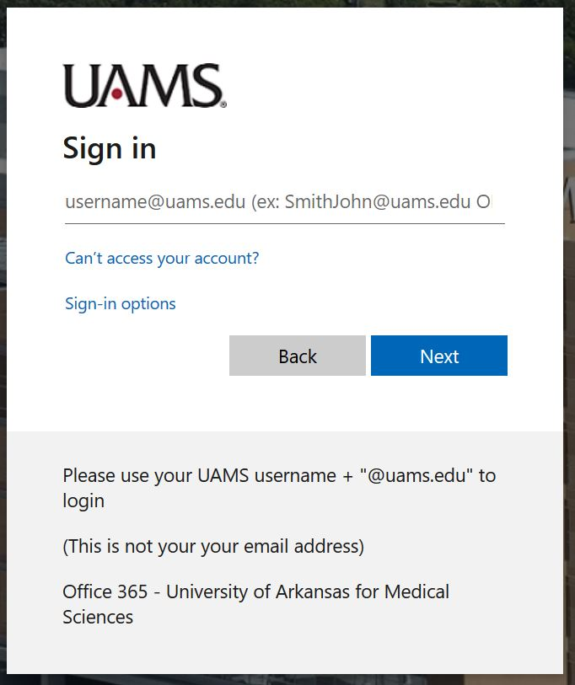
UAMS COI Disclosure System How to Update or Submit Your Annual Disclosure
Login with your UAMS Username and Password.
10/11/2020

Slide 3
UAMS COI Disclosure System How to Update or Submit Your Annual Disclosure
You may begin your COI form by clicking either Create/Edit My Certification or the hyperlink name of the disclosure form under my Inbox.
(for example, “Annual Disclosure Certification for User_Name 2020”)
10/11/2020

Slide 4
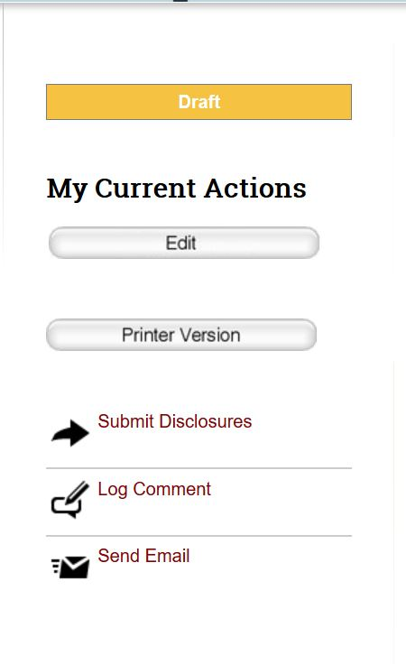
UAMS COI Disclosure System How to Update or Submit Your Annual Disclosure
Click on “Edit” to be taken to the first page of the form.
10/11/2020

Slide 5
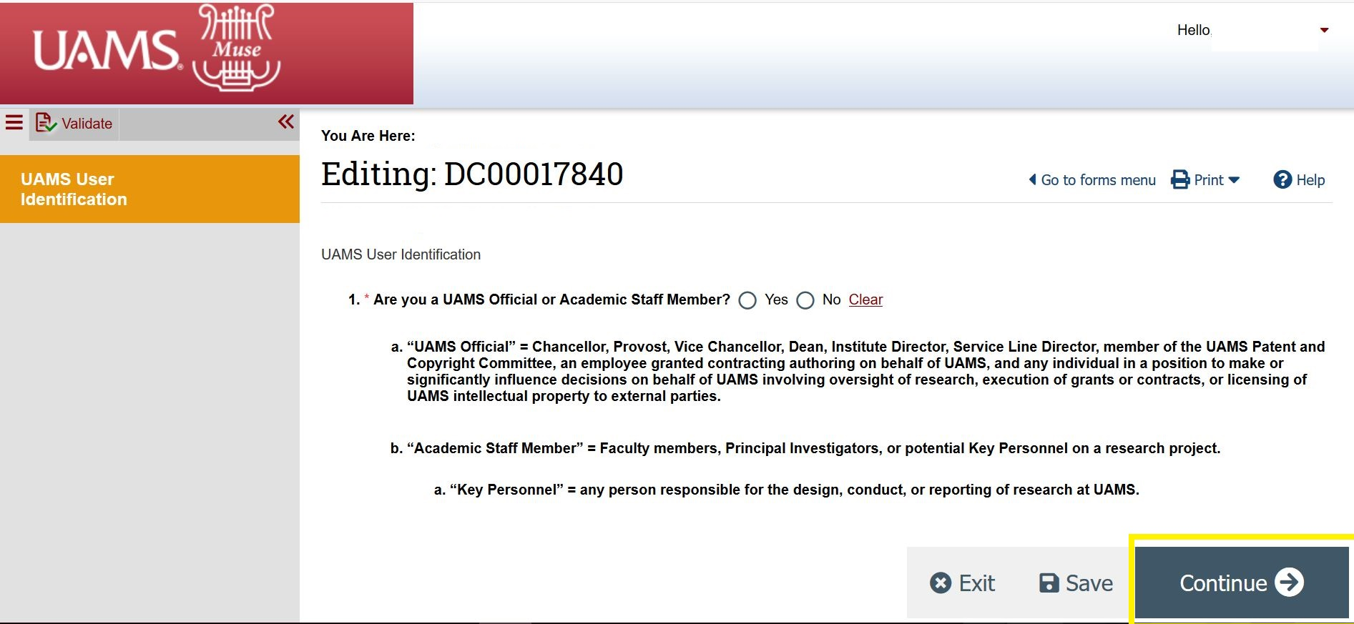
UAMS COI Disclosure System How to Update or Submit Your Annual Disclosure
UAMS User Identification Page: answer the one question and click Continue.
10/11/2020

Slide 6
UAMS COI Disclosure System How to Update or Submit Your Annual Disclosure
UAMS Responsibilities Page: answer the seven questions and click Continue.
If you have previously disclosed in this system, the questions will already be answered.
1) review your previous answers
2) change answers as needed
3) click Continue
10/11/2020

Slide 7
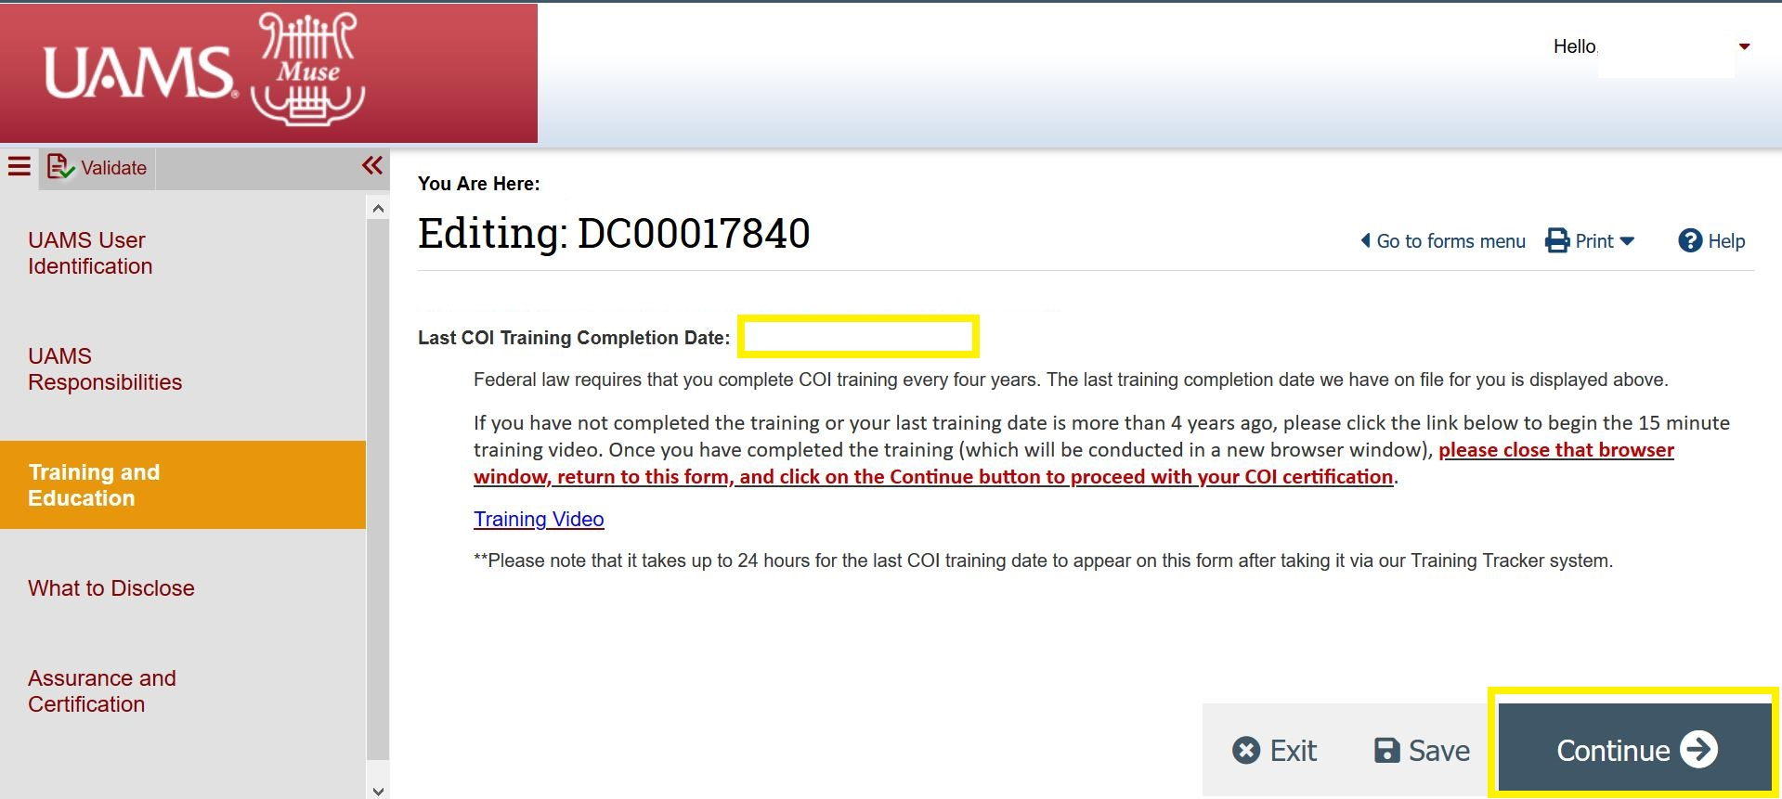
UAMS COI Disclosure System How to Update or Submit Your Annual Disclosure
Conflict of Interest Training: Training must be completed by investigators who participate in federally funded research. After viewing the training video through HR’s MyCompass system, you MUST come back to the Muse site to complete your disclosure.
10/11/2020

Slide 8
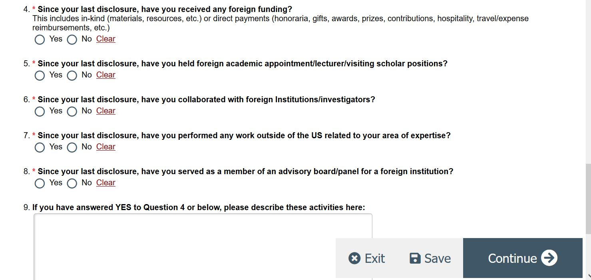
UAMS COI Disclosure System
How to Update or Submit Your Annual Disclosure
What to Disclose Page: This provides information on which outside interests must be disclosed. Answer the nine to ten questions at the bottom of the page and click Continue.
10/11/2020

Slide 9
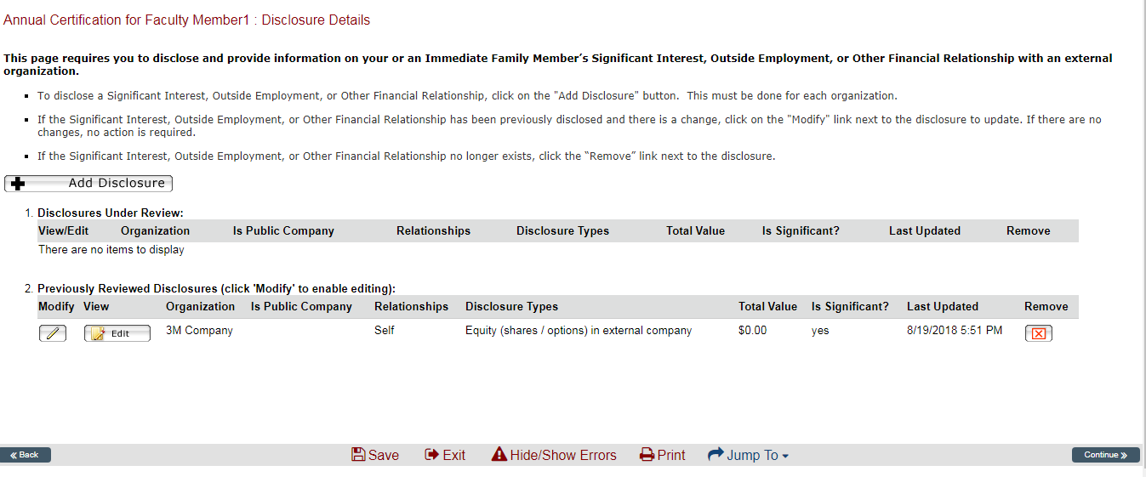
UAMS COI Disclosure System How to Update or Submit Your Annual Disclosure
Disclosure Details Page: Click on Add Disclosure to add information about an outside interest. (Move through the next five slides for detailed instructions on adding a disclosure.
Advance to slide 14 if you do not need instructions on adding disclosures.)
If you have previously disclosed in this system:
1) add new disclosures 3) remove disclosures that no longer exist
2) review previous disclosures 4) click Continue
10/11/2020

Slide 10
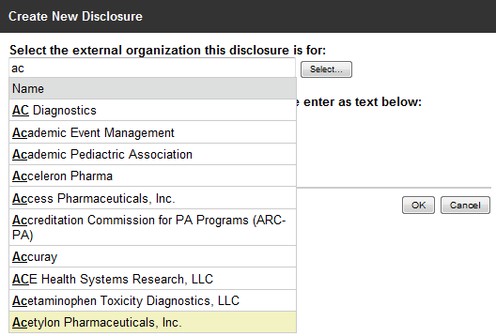
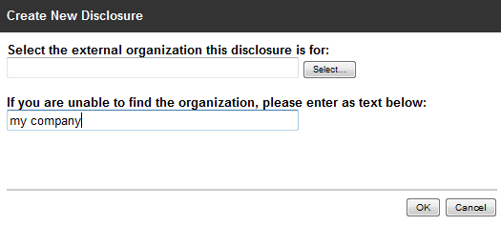
UAMS COI Disclosure System How to Update or Submit Your Annual Disclosure
Select the Organization from the list by typing the first few letters of the name. If you are unable to find your organization, enter the name in the second text box. Click OK.
10/11/2020

Slide 11
UAMS COI Disclosure System How to Update or Submit Your Annual Disclosure
General Information Page: Indicate if you or an Immediate Family Member has the outside interest and select the types of interests you have with the organization. Click Continue.
10/11/2020

Slide 12
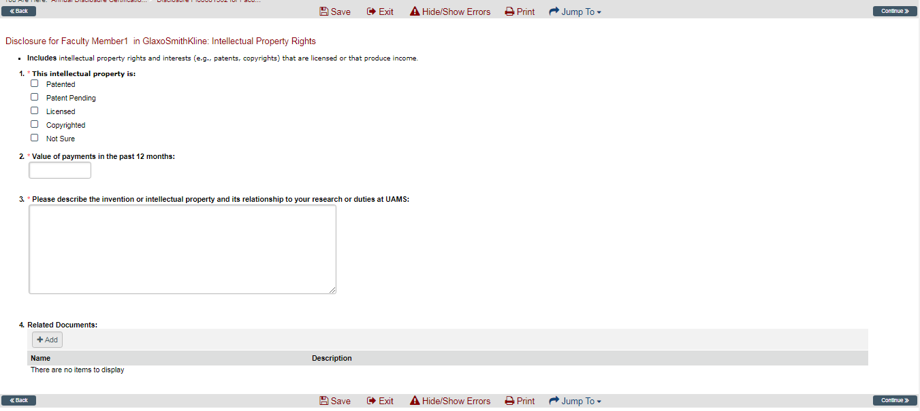
UAMS COI Disclosure System How to Update or Submit Your Annual Disclosure
Specific Information about outside interest: Answer all the questions related to the type of interest you selected and click Continue. If you selected more than one type of interest for an organization, you will have a page with questions for each type of interest. Below is the Intellectual Property Rights Page.
10/11/2020

Slide 13
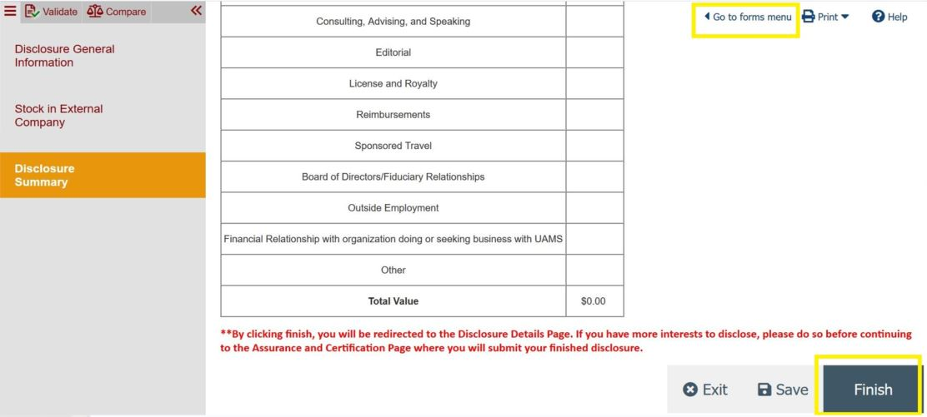
UAMS COI Disclosure System How to Update or Submit Your Annual Disclosure
Disclosure Summary Page: a summary of all information for the organization. If everything is correct, click Finish. If not, select “Go to forms menu” to correct. If not, use the Jump To menu to edit the information provided.
10/11/2020

Slide 14
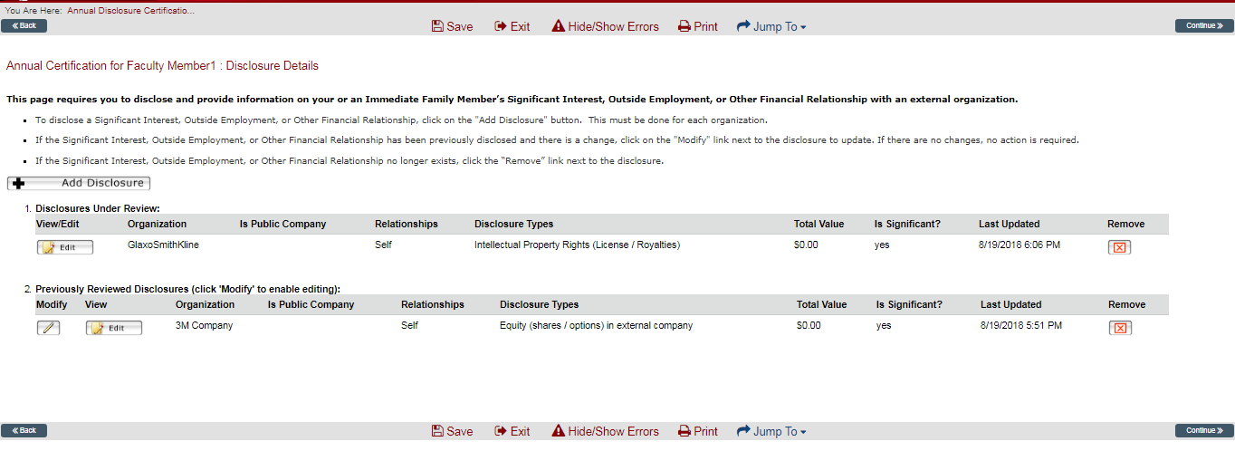
UAMS COI Disclosure System How to Update or Submit Your Annual Disclosure
Disclosure Details Page: if you have outside interests with another organization, click Add Disclosure. If not, click Continue.
10/11/2020

Slide 15
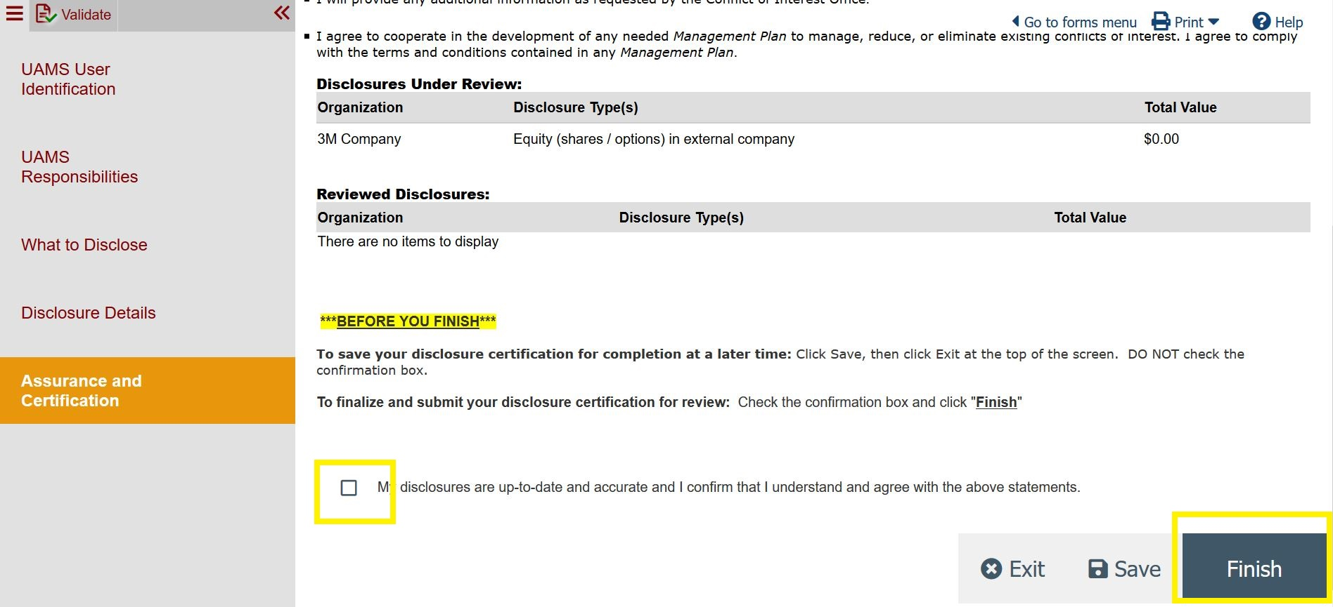
UAMS COI Disclosure System How to Update or Submit Your Annual Disclosure
Assurance and Certification Page: To complete your form and submit it to the COI office, check the box at the bottom of the page and click Finish.
10/11/2020

Slide 16
UAMS COI Disclosure System How to Update or Submit Your Annual Disclosure
UAMS COI Disclosure System
muse2.uams.edu
UAMS Conflict of Interest Office
501-686-6447 or 501-686-6168
PRPrincipe@uams.edu or WLAshley@uams.edu
http://coi.uams.edu/
10/11/2020

