Slide 1
Submitting your Annual Conflict of Interest Disclosure in Workday during the Annual Campaign
Conflict of Interest
* PLEASE NOTE, Academic Staff and Institutional Officials cannot make COI disclosures in Workday.

Slide 2
Non-Academic Staff Members are Non-Classified employees who (i) are not PRN or Temporary; (ii) are not Faculty or engaged in Research; and (iii) are not considered an Institutional Official. The COI policy requires Non-Academic Staff Members to update their COI disclosure within thirty (30) days of acquiring a new, reportable interest. Non-Academic Staff Members are responsible for obtaining the appropriate approval from their supervisor prior to engaging in external employment, in part to identify and properly manage potential conflicts of commitment. Outside Employment is not approved by the COI Office nor the Non-Academic COI Committee.
Conflict of Interest

Slide 3
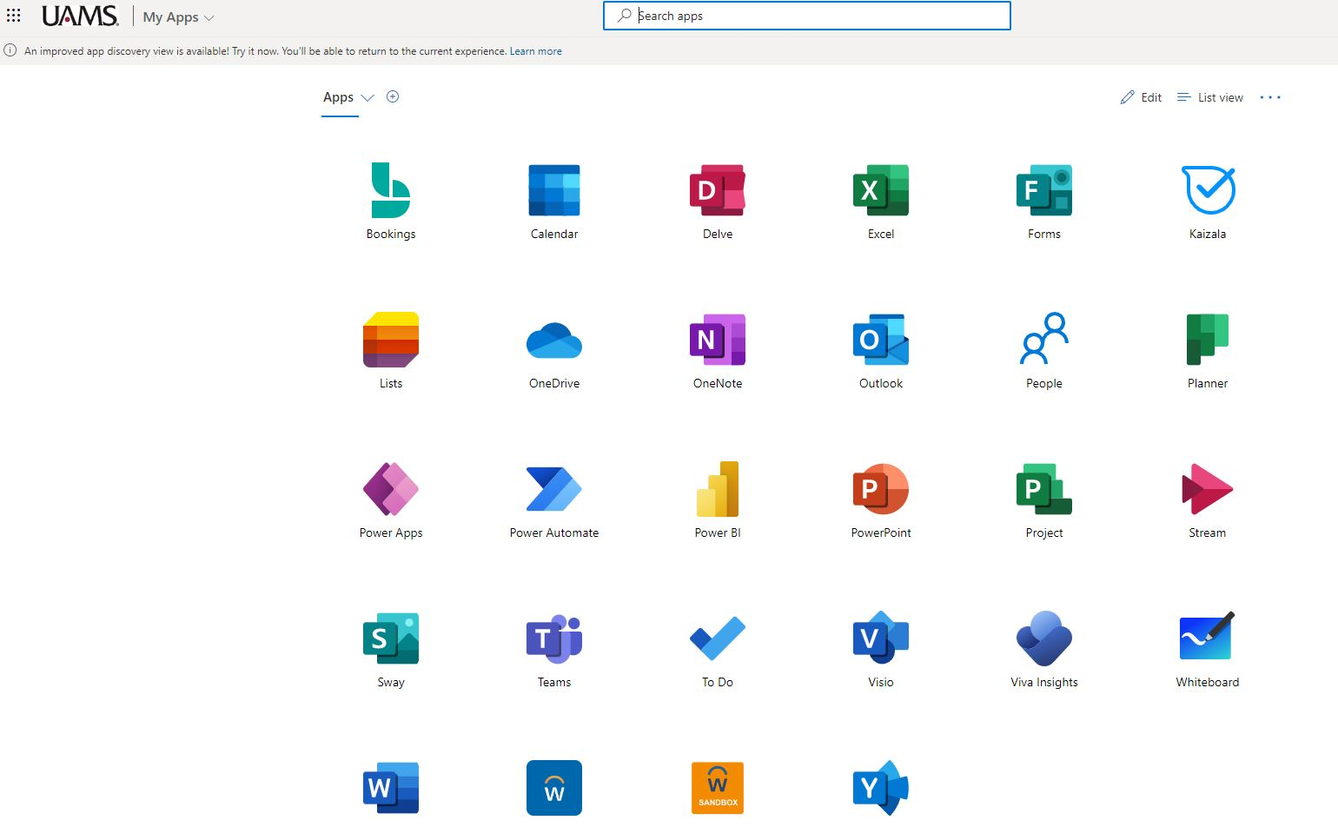
Conflict of Interest
Submitting your Annual COI Disclosure in Workday
Login to Workday by selecting the Workday icon in UAMS “My Apps”

Slide 4
Conflict of Interest
Submitting your Annual COI Disclosure in Workday
In Workday you will now see an Action item waiting for you, click on that COI Annual Disclosure Action item

Slide 5
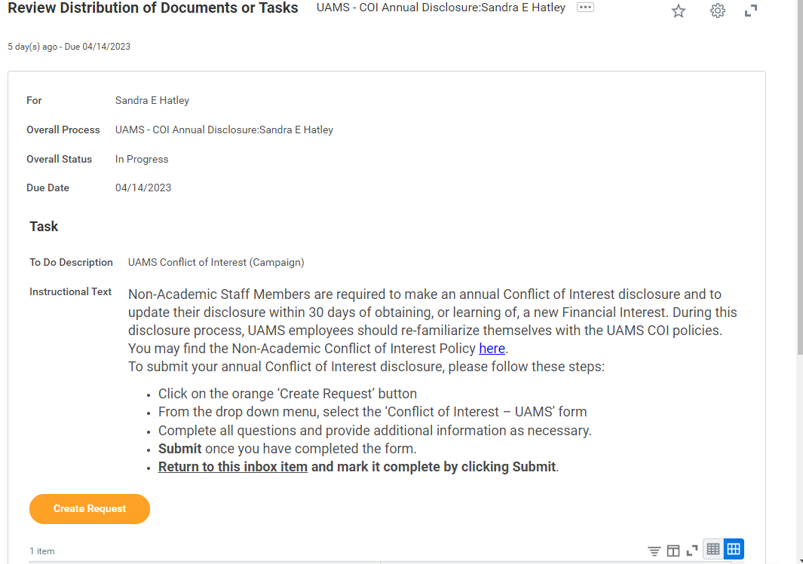
Conflict of Interest
Submitting your Annual COI Disclosure in Workday
Review the Distribution of Documents tasks and then click on the “Create Request” button

Slide 6
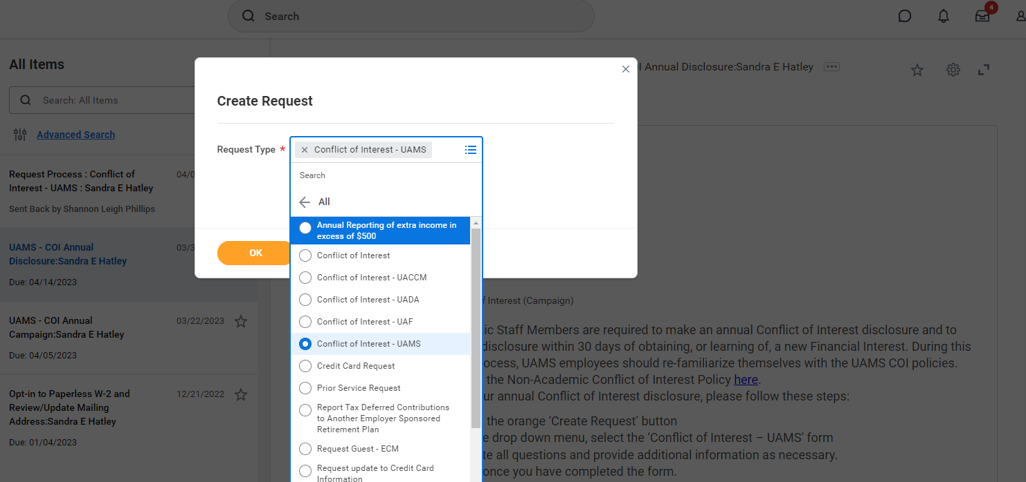
Conflict of Interest
Submitting your Annual COI Disclosure in Workday
In the Request Type box select “All” and then search for Conflict of Interest – UAMS, then click “ok.”

Slide 7
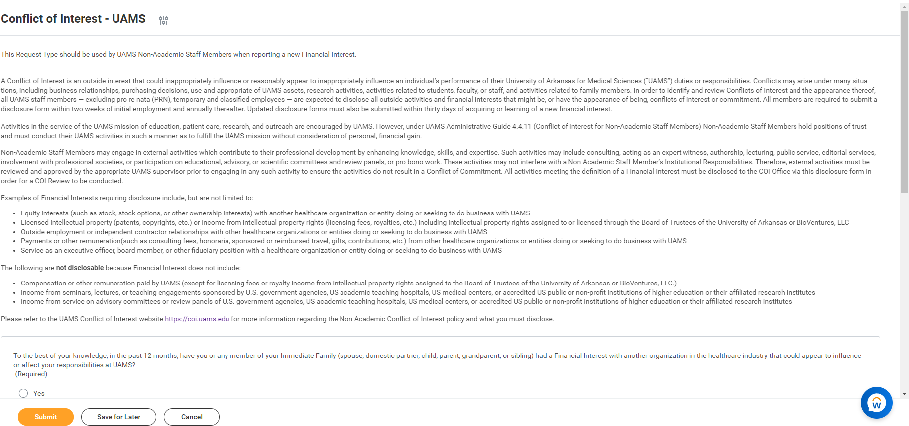
Conflict of Interest
Submitting your Annual COI Disclosure in Workday
Review instructions and the policy synopsis, then answer all questions appropriately. Once finished, please click on “Submit”

Slide 8
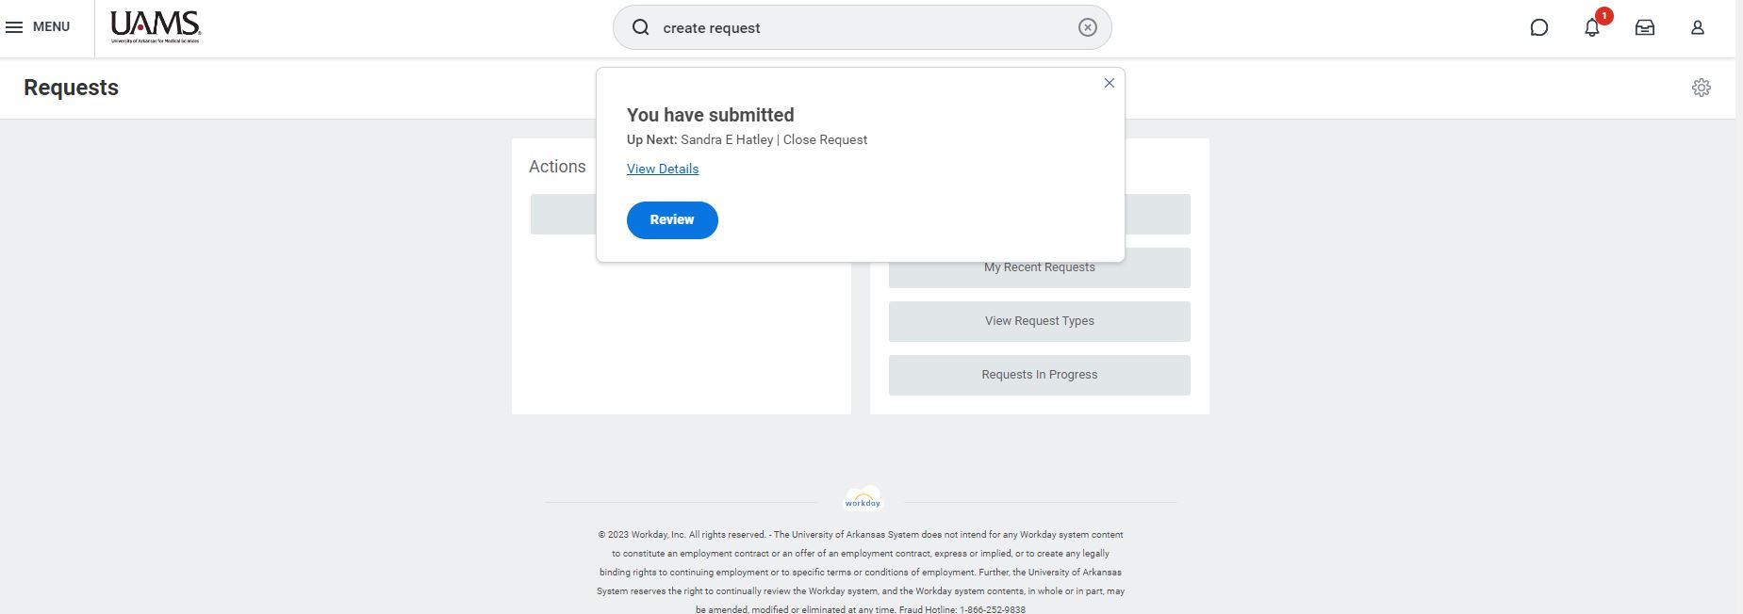
Conflict of Interest
Submitting your Annual COI Disclosure in Workday
After you have properly submitted your disclosure you will now see a message that reads “You have submitted”.

Slide 9
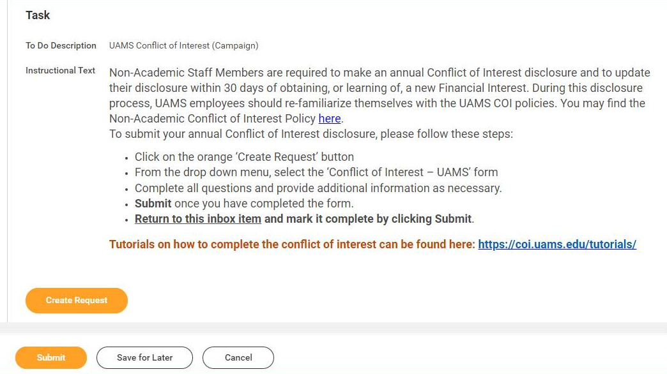
Conflict of Interest
Is the COI action item still present in your Workday inbox after submitting your disclosure?
Return to the inbox item and mark it complete by clicking Submit.

Slide 10
Conflict of Interest
UAMS Conflict of Interest Office
Contact Information:
Westley Ashley, JD
Director
501.686.6447
wlashley@uams.edu
Sandra Hatley, MHA, CRS
Assistant Director
501.603.1002
hatleysandrae@uams.edu

